Slide 1
Final Engagement
Attack, Defense & Analysis of a Vulnerable Network

Slide 2
Table of Contents
This document contains the following resources:
Network Topology & Critical Vulnerabilities
Traffic Profile
Normal Activity
Malicious Activity

Slide 3
Network Topology
& Critical Vulnerabilities
‹#›

Slide 4
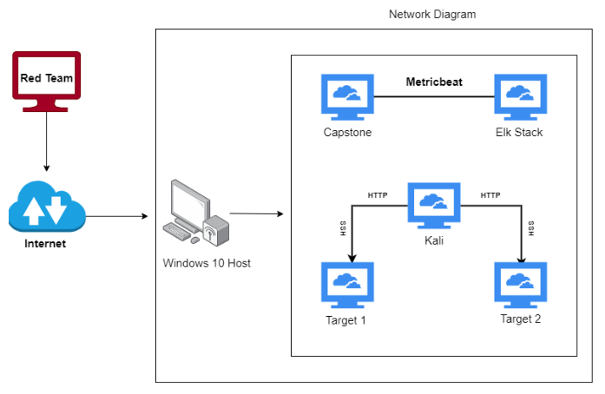
Network Topology
Network
Address Range: 192.168.1.0/24
Netmask:
Gateway: 192.168.1.1
Machines
IPv4: 192.168.1.110
OS: Debian
Hostname: target1
IPv4: 192.168.1.115
OS: Debian
Hostname: target2
IPv4: 192.168.1.100
OS:Ubuntu
Hostname: Kibana/Elasticsearch
IPv4: 192.168.1.105
OS:Ubuntu
Hostname: Capstone
IPv4: 192.168.1.90
OS:Debian
Hostname: Kali
[Insert Here]
Use draw.io to create a diagram of the network.
Add your diagram to this slide and fill out the data in the sidebar.

Slide 5
Critical Vulnerabilities: Target 1
Our assessment uncovered the following critical vulnerabilities in Target 1.
Vulnerability | Description | Impact
User michael had weak password | Password was his User ID | Easily exploited login credentials to logon to the Wordpress server over SSH
Wordpress Config File had invalid permissions | wp-config.php was world readable and contained the DB login credentials | Attacker was able to read hashed passwords in the WORDPRESS database.
Weak password in Wordpress database | Ran John the Ripper against hashed passwords and cracked Steven’s | Access to the admin pages for the Wordpress server.
Server was vulnerable to wpscan | Provided user names | Provided user names

Slide 6
Traffic Profile
‹#›

Slide 7
Traffic Profile
Our analysis identified the following characteristics of the traffic on the network:
Feature | Value | Description
Top Talkers (IP Addresses) | 172.16.4.205 10.0.0.201 185.243.115.84 | Machines that sent the most traffic.
Most Common Protocols | TCP - 87% TLS - 12.5 % UDP - 12.8 | Three most common protocols on the network.
# of Unique IP Addresses | 810 | Count of observed IP addresses.
Subnets | 255.255.255.0 | Observed subnet ranges.
# of Malware Species | 1 - Trojan / (June11.dll) | Number of malware binaries identified in traffic.
Notes:
You may have more than 2 subnets.

Slide 8
Behavioral Analysis
Purpose of Traffic on the Network
Users were observed engaging in the following kinds of activity.
“Normal” Activity
Watching Youtube
Browsing mysocalledchaos.com
Downloading a ton of GIFs from b5689023.green.mattingssolutions.co
Suspicious Activity
Downloading Malware june11.dll
Browsing cdn.iphonehacks.com

Slide 9
Normal Activity
‹#›

Slide 10
[Browsing Websites]
Summarize the following:
What kind of traffic did you observe? Which protocol(s)?
TCP
HTTP
KERBOSE
DHCP
DNS
What, specifically, was the user doing? Which site were they browsing? Etc.
www.mysocalledchaos.com
fakeurl.htm
b5689023.green.mattingssolutions.co

Slide 11
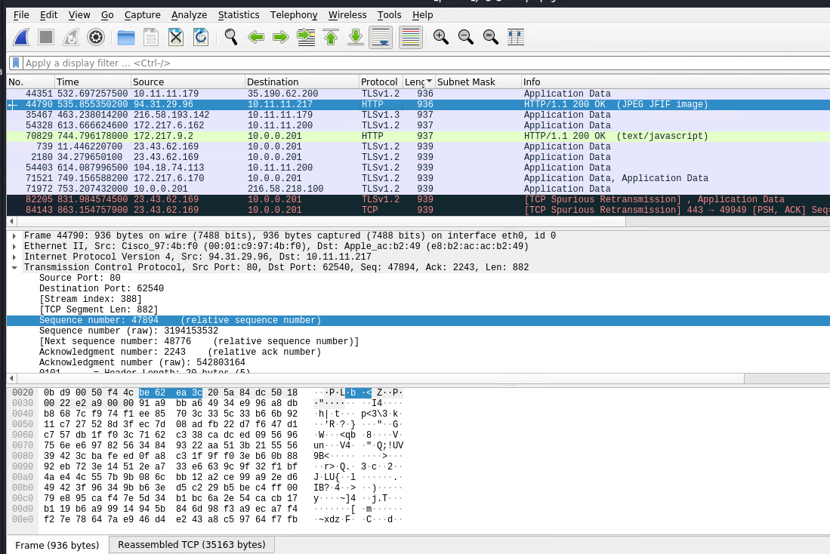

Slide 12
Malicious Activity
‹#›

Slide 13
[Downloading Virus]
Summarize the following:
What kind of traffic did you observe? Which protocol(s)?
HTTP
What, specifically, was the user doing? Which site were they browsing? Etc.
the user downloaded a trojan from http://205.185.125.104/files/june11.dll

Slide 14
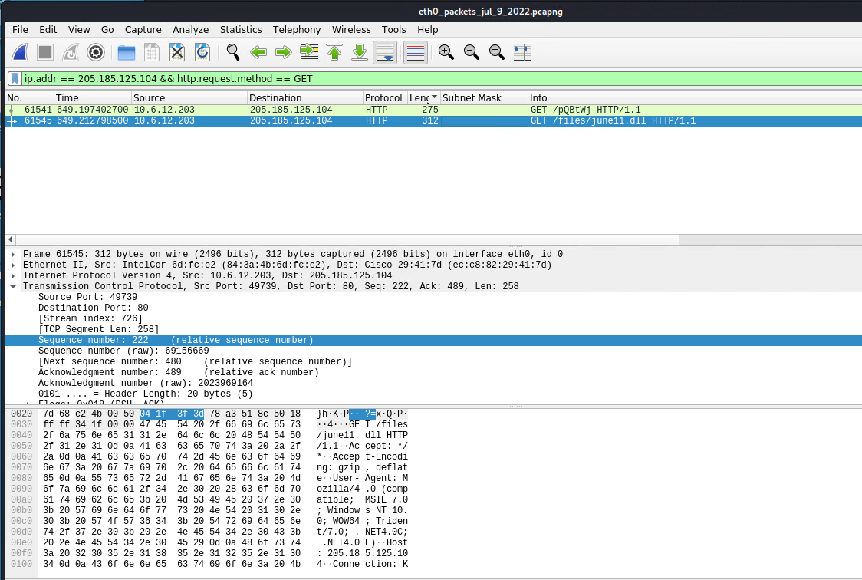

Slide 15
The End
‹#›

